Slide 1
Food Distribution Program
WBSCM Requisitions:
Part I
Texas Department of Agriculture
USDA Division

Slide 2
Why WBSCM?
The FDP Module in TX-UNPS does not have an upgrade.
Since 2010, TDA has used the Web Based Supply Chain Management System (WBSCM) to submit RA orders to USDA.
USDA owns and regularly upgrades WBSCM, making it the best solution to serve RAs in Texas now and in the future.
Notes:
Review information on slide with RAs

Slide 3
Acknowledgement Statement
You understand and acknowledge that:
The training you are about to take does not cover the entire scope of the program; and that
You are responsible for knowing and understanding all handbooks, manuals, alerts, notices, and guidance, as well as any other forms of communication that provide further guidance, clarification, or instruction on operating the program.

Slide 4
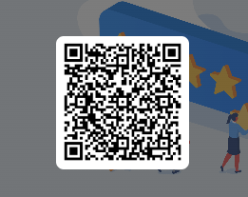
RA User Check-In:
RA103 Requisitions:
Scan the QR to access the survey or click on the link below.
https://bit.ly/3rlmTnZ
Notes:
Users complete survey via QR Code or link/URL

Slide 5
01
Course Introduction
Course Outline and Objectives

Slide 6
01
Introduction
Course Overview and Objectives
02
Fulfillment Overview
Understanding process, requisition related terms and definitions
03
Direct Delivery Requisition via Browse Catalog
03
Direct Delivery: selecting products, delivery dates, and Ship-To locations; saving to draft, submitting requests via browsing catalog function
WBSCM Requisitions Part I
Course Outline

Slide 7
Course Objectives and Outcomes
By the end of this course, participants will be able to:
Understand WBSCM Requisition Terminology and Acronyms
Understand how to create a requisition for Direct Delivery via Browse Catalog, including:
Entering quantities
Selecting delivery location
Selecting delivery dates
Saving As Draft
Submitting requisition to TDA for review

Slide 8
02
Fulfillment Overview

Slide 9
High Level Fulfillment Process
TDA
Distributes
Entitlement
RA
Submits
Requisition
(Req #)
TDA
Creates
Sales Order
USDA
Approves
Sales Order
(SO # Created)
Vendor
Fulfills SO
(PO # Created)
Goods
Delivered to Warehouse/
Processor
(Receipting)
WBSCM only has visibility from Entitlement to Initial Delivery Point
Notes:
NOTE: Initial delivery point will be warehouse (state-contracted or RA for Direct Ship RAs) or processors. RAs will use processor and warehouse tracking system when materials requested in WBSCM arrive at the designated Ship-To/initial delivery point.

Slide 10
TX-UNPS vs. WBSCM Terms and Definitions
TX-UNPS | WBSCM | Definition
 | Requisition | Pre-cursor to a sales order. RAs create a requisition when they wish to order goods in WBSCM.
Surveys | Catalog | Formerly known as surveys. Medium used to organize material or product to place requisitions in WBSCM.
Delivery Order | Sales Order | Formerly known as delivery orders. Orders created by TDA to indicate sale of products. SO (Sales Order) created after requisitions have been created, submitted, consolidated, and approved and before item goes to procurement for sourcing. This is done before the creation of a purchase requisition (PR).
Notes:
Review terminology on slide with RAs

Slide 11
03
Direct Delivery via Catalog

Slide 12
Training Portal Log-In
ESCs and RA Users Log In To WBSCM Training Environment
Login Required To Complete Assessment Questions URL: wbscmntrn.wbscm.usda.gov
RA Training Environment Username and Password previously provided via e-mail.
Note the "ntrn" section of web address
This indicates the training environment
Notes:
Highlight the difference between training environment vs. Production URLs.
Production environment does not have the "ntrn" component in the web address.
Logins previously provided via to RAs for training environment
Log in to training environment will be different from login to username for live system which occurs after all required training is complete.

Slide 13
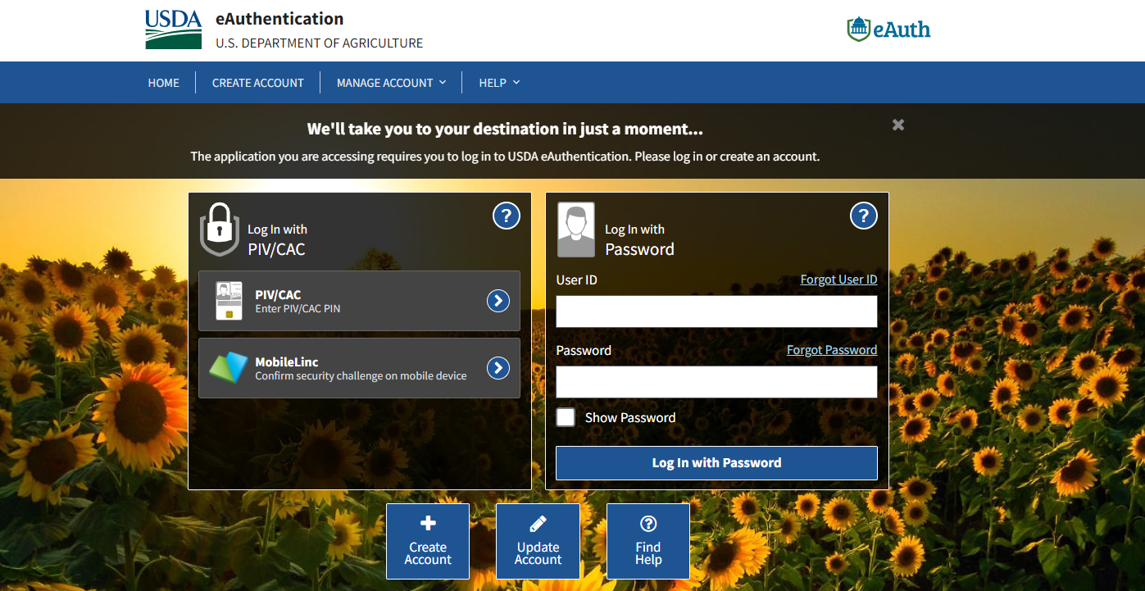
Log On To WBSCM Training Environment
Enter Training User Login
Training Environment Login Page looks identical to Live Production Login Page.
Bookmark training environment link to minimize login errors.
traininguserinfo@training.org
assigned.training.password
Enter training password
Click log in button
Notes:
TRAINER NOTE:
Training Environment and Live Production Log In Page will look the same.
Bookmark training environment which includes “ntrn” in the URL.
Training environment logins will include no personal user information.
The next slides will be a review of WBSCM RA view and reminder to check for new content. Will be particularly helpful for those conducing training over multiple weeks.

Slide 14
Training Environment Log-In
RA Training Environment View
NTRN icon signals training environment.
User and Organization Name
ESC Training Environment View
NTRN icon signals training environment.
User and Organization Name
Notes:
User name and organization will show different user roles. Differences in navigation panels will be determined based on roles/level of access. Let participants know what NTRN stands for (Training Environment)

Slide 15
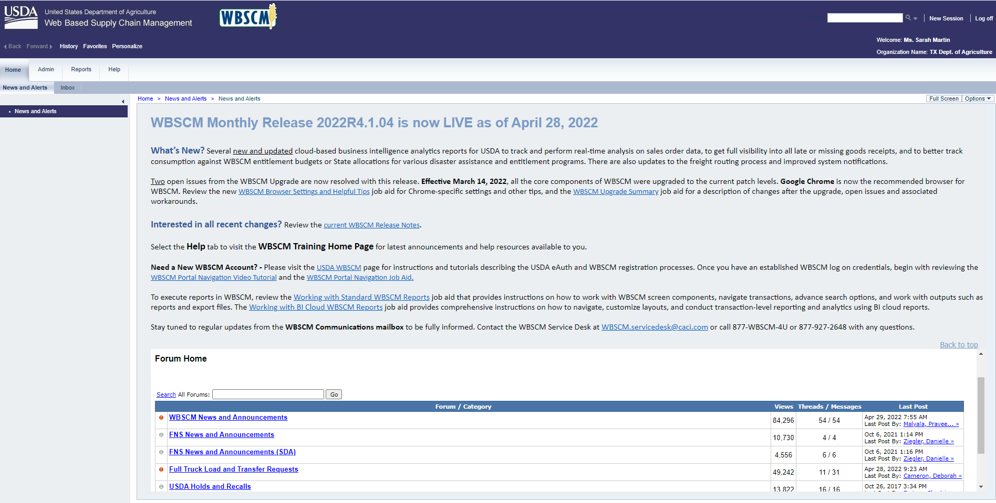
Check for New Content
Check Forum for updates.
Notes:
Review importance of checking forum for updates/announcements when they have access to Live Production environment

Slide 16
Direct Delivery via Catalog
Create A New Requisition for Each Ship-To Location
Example:
Request #1 → Direct Delivery (Contracted Warehouse)
Request #2 → Processing Ship To Location #1
Request #3 → Processing Ship To Location #2
Direct Delivery via Catalog
Notes:
Users may also want to create requisitions to each location site by commodity group.
Ex:
Direct Delivery Fruits and Veggies
Direct Delivery Meat
Direct Delivery Poultry, etc. etc.

Slide 17
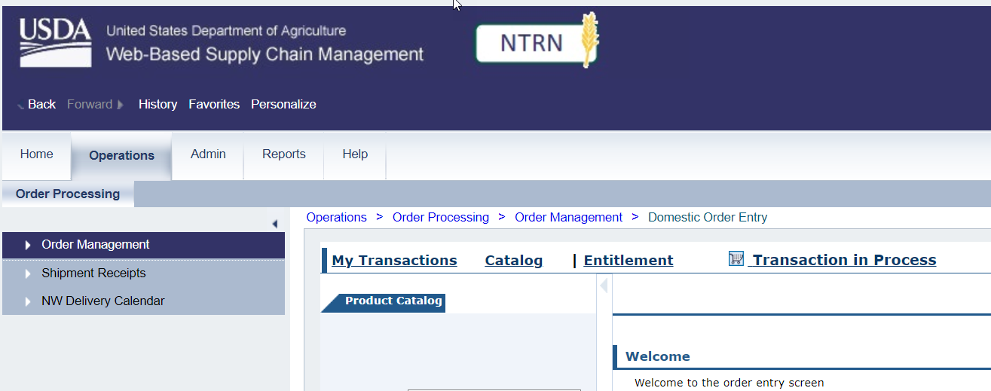
Direct Delivery via Catalog
1
Click On Operations
Click On Order Management
2
Notes:
To request Direct Delivery via Catalog (formerly known as surveys) follow the next set of steps on each slide.

Slide 18
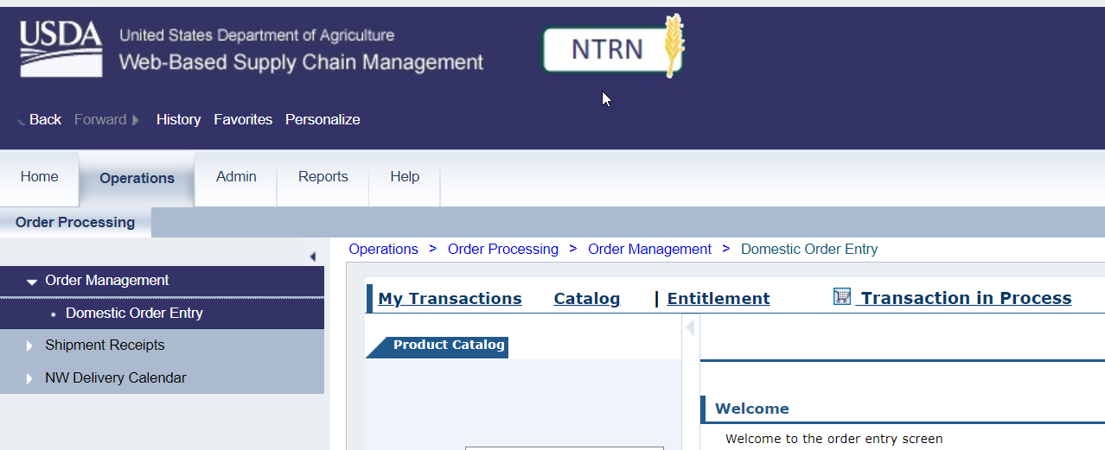
Direct Delivery via Catalog
*Note: This part of the process is a request for materials. This is not an order submission.
Click On Domestic Order Entry
3
Notes:
NOTE: The Product Catalog Screen may auto-populate.
At this point of the fulfillment process, RAs will request their foods to be delivered to their desired Ship-To destination (for Direct Delivery, either Direct Ship or State-Contracted).
TDA will submit those requests to USDA on their behalf.

Slide 19
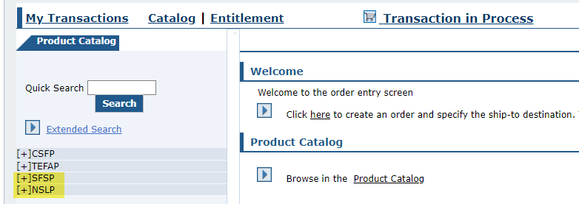
Direct Delivery via Catalog
Main Content Area Showcasing Domestic Order Entry Screen
Programs

Slide 20
Direct Delivery via Catalog
Hide Nav. Panel by clicking arrow
Notes:
To view the product catalog panel and/or to enlarge main content area, hide navigation panel by clicking arrow.

Slide 21
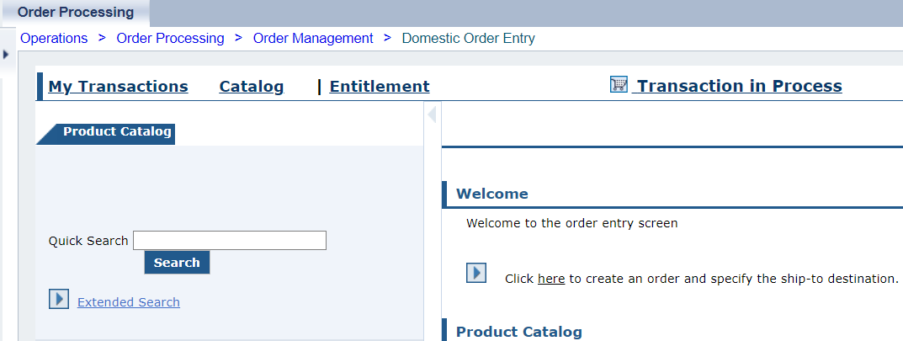
Direct Delivery via Catalog
Domestic Order Entry Screen with Navigation Panel hidden.
Notes:
NOTE: Remind users that this is not an ORDER despite the name of the entry screen. This is a REQUISITION for SDA to order on behalf of RAs.

Slide 22
Direct Delivery via Catalog
User needs to locate available products in catalog for requisition.
Direct Delivery via Browse Catalog
Processing Diversion via Extended Search
(*Locate specific product by material code or key word)
Notes:
This PPT will focus on requesting Direct Delivery via Catalog

Slide 23
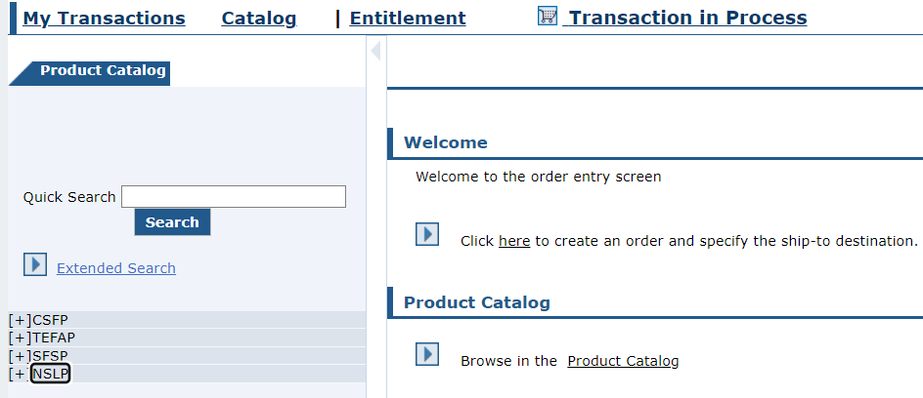
Direct Delivery via Catalog
Click + button next to appropriate program​
1
Direct Delivery via Catalog
Notes:
NOTE: Remind users that this is not an ORDER despite the name of the entry screen. This is a REQUISITION for SDA (TDA) to order on behalf of RAs.

Slide 24
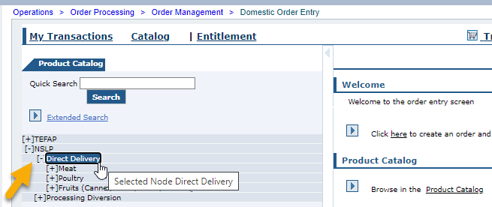
Direct Delivery via Catalog
Click + button next to Direct Delivery
2
Direct Delivery via Catalog
Notes:
While Processing Diversion is available via Catalog, RAs should request Processing via Extended Search Only and Direct Delivery via Catalog
This portion of training focuses on Direct Delivery via Catalog.

Slide 25
Direct Delivery via Catalog
Direct Delivery (formerly Brown Box):
Material sourced from vendor and delivered as-is to customer.
Direct Delivery via Catalog
Notes:
Catalog "Order" Options based on User Role/Program Selected
NOTE: Remind users that this is not an ORDER despite the name of the entry screen. This is a REQUISITION for SDA (TDA) to order on behalf of RAs.

Slide 26
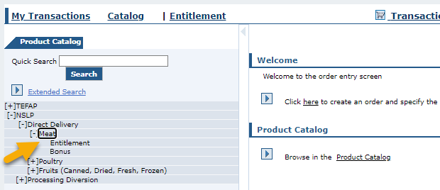
Direct Delivery via Catalog
Click + button next to appropriate material/product group available to user
Example: Meat (product) selected under Direct Delivery (request type).
3
Direct Delivery via Catalog
Notes:
Select Direct Delivery Commodity group that is desired

Slide 27
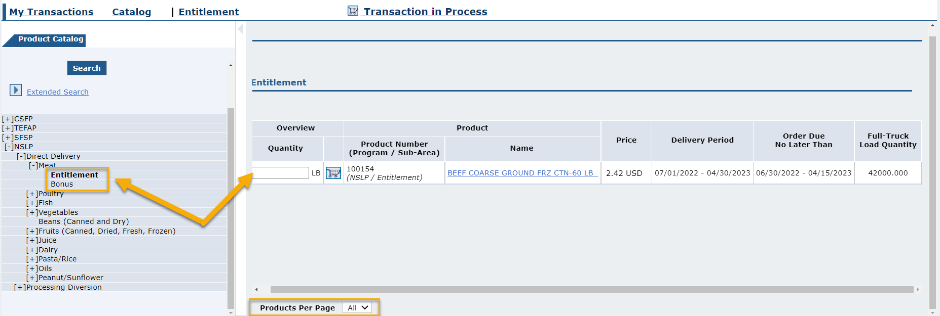
Direct Delivery via Catalog
4
Choose between Entitlement and Bonus
Example:
Entitlement (not Bonus) option selected under Meat
Direct Delivery via Catalog
Notes:
After making selections, review catalog information that will appear in the main content area.

Slide 28
Entitlement Budget Selection
Entitlement:
Ordering these products will decrease entitlement balance.
Direct Delivery via Catalog
Notes:
After making selections, review catalog information that will appear in the main content area.

Slide 29
Entitlement Budget Selection
Bonus:
Ordering bonus products will not impact entitlement balance.
Direct Delivery via Catalog
Notes:
FNS may offer bonus commodities when there is surplus.

Slide 30
Domestic Order Shopping Cart Screen
List of products available for selected criteria displayed.
Direct Delivery via Catalog
Notes:
After making selections, review catalog information that will appear in the main content area.

Slide 31
Domestic Order Shopping Cart Screen
Can adjust number of products to display at bottom of list
Direct Delivery via Catalog

Slide 32
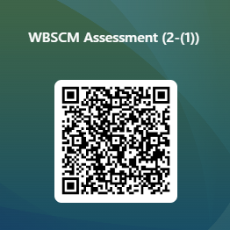
RA-Assessment:
Scan QR Code to access the assessment or click/type the link below in your browser.
https://forms.office.com/r/rEdmq9dELn
Notes:
RAs must submit assessment responses via QR Code or URL/link in order to receive credit

Slide 33
Domestic Order Shopping Cart Screen
Do not enter value in Quantity field
Direct Delivery via Catalog
Notes:
Review information on slide with RAs

Slide 34
Domestic Order Shopping Cart Screen
5
Click Shipping Cart icon next to product to view product details and available delivery dates
Direct Delivery via Catalog
Notes:
Review information on slide with RAs

Slide 35
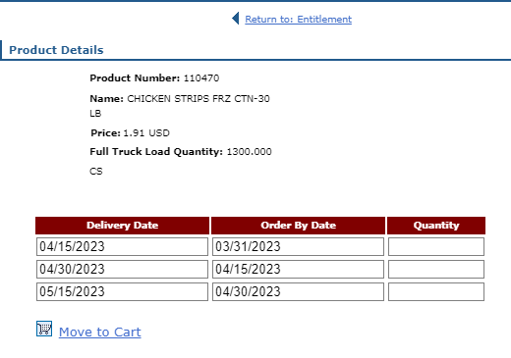
Product Detail and Delivery Dates
Product Details
If scroll bar is present, use to see all available dates
Direct Delivery via Catalog
Notes:
Review information on slide with RAs

Slide 36
Product Detail and Delivery Dates
Delivery Date
Range of dates when commodities may be delivered to selected Deliver To/ Ship-To (Contracted Warehouse for Direct Delivery)
Pre-populated/not editable.
Direct Delivery via Catalog
Notes:
Review information on slide with RAs
The delivery date is the date the material will arrive at the Warehouse for Direct Delivery

Slide 37
Product Detail and Delivery Dates
Order By Date
Last date to submit request for the corresponding Delivery Date.
Pre-populated/not editable.
Direct Delivery via Catalog
Notes:
Review information on slide with RAs

Slide 38
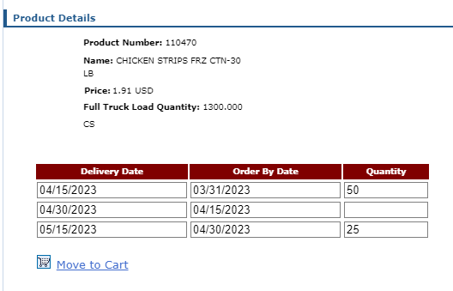
Product Detail and Delivery Dates
Quantity
Add desired Quantity in the field next to the desired Delivery Date / Order By Date pair(s).
6
Direct Delivery via Catalog
Notes:
Review information on slide with RAs
RAs should spread out quantities throughout the school year as needed instead of requesting all quantities on the first delivery date

Slide 39
Product Detail and Delivery Dates
Click Move to Cart to add selected product quantities to shopping cart
7
Direct Delivery via Catalog
Notes:
Review information on slide with RAs

Slide 40
Direct Delivery via Catalog
Portal returns to Domestic Ordering Screen
View Cart summarizes items added and value
Direct Delivery via Catalog
Notes:
Review information on slide with RAs
(Note) A summary at the top of the screen displays the number and total value of products contained in the shopping cart.

Slide 41
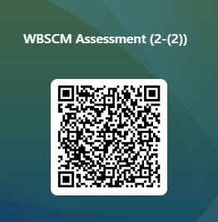
RA-Assessment:
Scan QR Code to access the assessment or click/type in the link below in your browser.
https://forms.office.com/r/aTV6Q8ez1Q
Notes:
RAs must submit assessment responses via QR Code or URL/link in order to receive credit

Slide 42
Direct Delivery via Catalog
Repeat Browse Catalog For Other Product Items For The Same Ship-To Destination
Direct Delivery via Catalog

Slide 43
Direct Delivery via Catalog
View Cart
Click View Cart link to review request
8
Cart will not save if:
system times out
user logs off before submitting request
Direct Delivery via Catalog
Notes:
Review information on slide with RAs

Slide 44
In Process Screen: Maximize View
Can click arow to hide Transactions panel
Direct Delivery via Catalog
Notes:
Review information on slide with RAs

Slide 45
Add Descriptive Information
Reference & Description
RAs can add descriptive information to each requisition for easier identification and clarification later in WBSCM.

Slide 46
In Process Screen: Add Reference
Optional: Complete Your Reference
9
Your Reference allows further clarification by referring to other relevant information.
Direct Delivery via Catalog
Notes:
Review information on slide with RAs

Slide 47
In Process Screen: Add Description
Optional: Complete Your Description
10
Your Description is a free text field describing the requisition.
Direct Delivery via Catalog
Notes:
Review information on slide with RAs

Slide 48
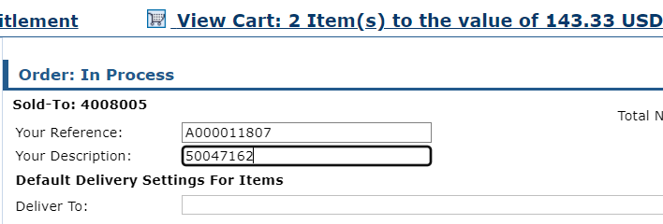
In Process Screen: Example
Example
Your Reference: A000011807
Your Description: 500471672
Direct Delivery via Catalog
Notes:
Review information on slide with RAs
RAs may choose whatever reference or description that best serves their organization’s needs. These fields are optional
Ex: Some may choose to use description or reference to designate commodity groups or materials requested in each specific transaction.

Slide 49
In Process Screen: Update
Scroll down to access Update button
Click Update
11
Direct Delivery via Catalog
Notes:
Review information on slide with RAs

Slide 50
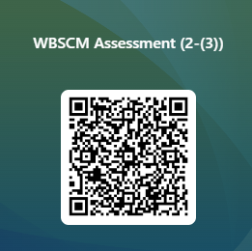
RA-Assessment:
Scan QR Code to access the assessment or click/type in the link below in your browser.
https://forms.office.com/r/NEY6e91r5d
Notes:
RAs must submit assessment responses via QR Code or URL/link in order to receive credit

Slide 51
Select Ship-To Destination
Apply All
All line items of goods in the cart will have the same Deliver To (Ship-To) location.
Notes:
TDA guidance: Each requisition will focus on one Ship-To destination. Applying All helps with designating destination efficiently.

Slide 52
Select Deliver To/Ship-To
Click dropdown in Deliver To field to select appropriate Ship-To location
1
Direct Delivery via Catalog
Notes:
Review information on slide with RAs
Underneath the reference and description sections, the Deliver To section will be used to select desired Ship-To locations (Contracted Warehouse for Direct Delivery)

Slide 53
Deliver To/Ship-To Apply All
To apply Ship-To location to all line items, click Deliver To Selection check box in header
2
Direct Delivery via Catalog
Notes:
Review information on slide with RAs

Slide 54
Deliver To/Ship-To Apply All
3
Click Update
Direct Delivery via Catalog
Notes:
Review information on slide with RAs

Slide 55
Deliver To/Ship-To Apply All
a
Oops!
Need to remove an item?
Check the boxes next to materials to remove.
Click update to remove materials.
Direct Delivery via Catalog
Notes:
Review information on slide with RAs

Slide 56
Update Draft Status
Update To Draft
Update Requisitions to Draft Status to conduct Quality Assurance
Notes:
TDA guidance: Save Requisitions to Draft to conduct Quality Checks

Slide 57
Update Draft Status
1
Mark requisition as Draft to conduct QA (Quality Assurance Check)
Change “User Status” from “Ready for Approval” to “Draft” status for each line item
Direct Delivery via Catalog
Notes:
Review information on slide with RAs

Slide 58
Update Draft Status
2
Click dropdown arrow for each item
Click dropdown arrow for each line item to change to “Draft” status
Direct Delivery via Catalog
Notes:
Review information on slide with RAs

Slide 59
Update Draft Status
Select “Draft”
3
Select “Draft” from dropdown menu
Direct Delivery via Catalog
Notes:
Review information on slide with RAs

Slide 60
Update Draft Status
4
Confirm User Status for every line item is set to “Draft”
Direct Delivery via Catalog
Notes:
Review information on slide with RAs

Slide 61
Update Draft Status
Click Update
5
Click “Update” to save each line-item status as “Draft”
Direct Delivery via Catalog
Notes:
Review information on slide with RAs

Slide 62
Submit Requisition As Draft
Click “Order” to save as Draft
6
*Note:
TDA cannot review requisitions in Draft
Direct Delivery via Catalog
Notes:
Note*
TDA cannot submit requisitions in Draft Status to USDA
The upcoming slides include:
Best practice process includes RAs conducting Quality Assurance checks for requisitions in Draft Status to minimize errors before submitting as Ready for Approval to TDA
Once quality assurance checks are complete, all requisitions must be marked as Ready for Approval and submitted to TDA

Slide 63
Submit Requisition As Draft
When Requisitions Are in Draft Status:
Requisitions have not been submitted to TDA
TDA cannot order any materials in “Draft”
Total price does count against entitlement balance.
Direct Delivery via Catalog
Notes:
Review information on slide with RAs

Slide 64
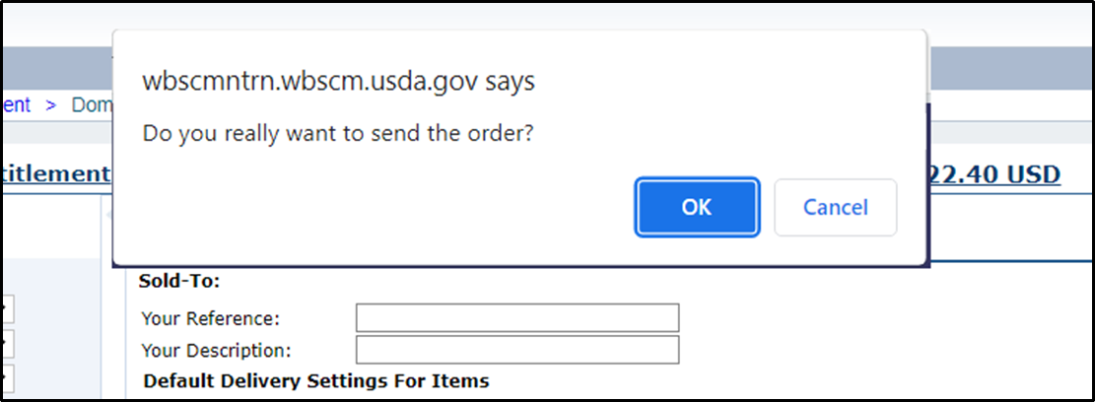
Submit Requisition As Draft
Click OK button in pop-up window to confirm.
7
*Note:
Clicking “OK” saves the requisition as a Draft
Direct Delivery via Catalog
Notes:
Review information on slide with RAs

Slide 65
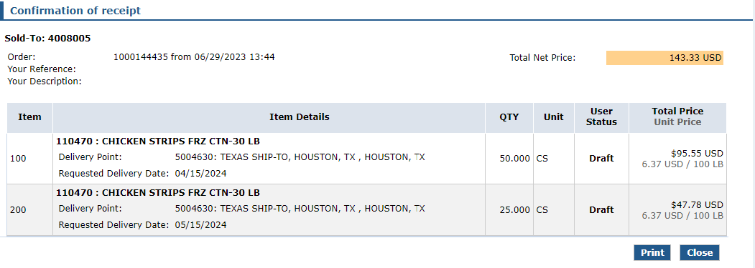
Requisition Draft Receipt Confirmation
Confirmation appears
Status marked as Draft
Has not been submitted to TDA
8
9
Requisition # assigned to transaction
10
Direct Delivery via Catalog
Notes:
Review information on slide with RAs

Slide 66
Submit Requisition As Draft
Print to conduct Quality Assurance Review
Click Print
11
Direct Delivery via Catalog
Notes:
At this point in the process, TDA does not have the ability to submit requisitions marked as Draft to USDA
Quality Assurance Check should be completed by an additional staff member to review and minimize errors before submitting to TDA as Ready for Approval

Slide 67
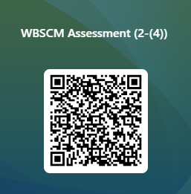
RA-Assessment:
Scan QR Code to access the assessment or click/type in the link below in your browser.
https://forms.office.com/r/fviKeCrYyR
Notes:
RAs must submit assessment responses via QR Code or URL/link in order to receive credit

Slide 68
Quality Assurance Checks
Quality Assurance: Identifying errors before submission
Notes:
QA Checks serve as best practice to minimize or reduce errors prior to submitting to TDA

Slide 69
Conduct Quality Assurance
1
Select additional staff members to conduct Quality Assurance Checks Use Requisition Checklist for guidance Staff should check requisitions for:
Quantities
Unit of Measure
Ship-To Location
Delivery Dates to selected Ship-To Location
2
3
Direct Delivery via Catalog
Notes:
Quality Assurance Checks should be conducted by additional staff members prior to submitting requisitions as Ready For Approval to TDA
Quality Assurance Checks can assist in proactively reducing and minimizing errors

Slide 70
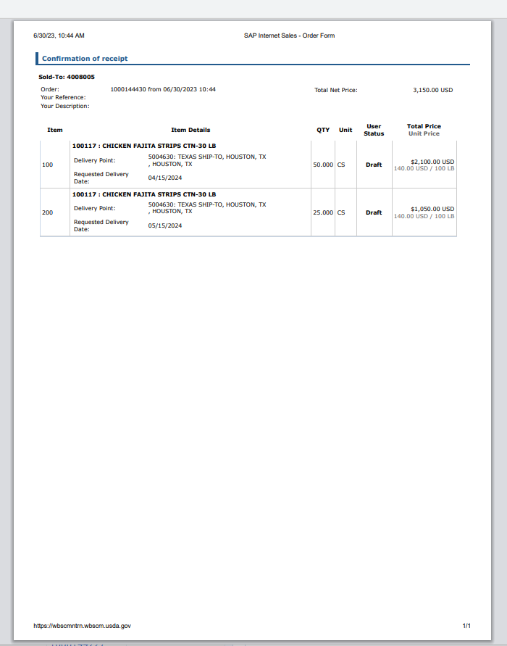
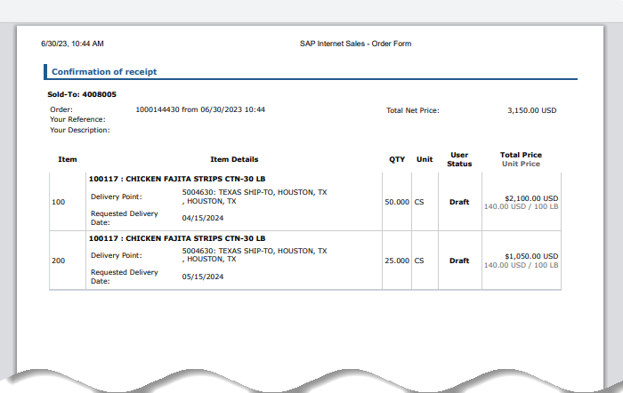
Quality Assurance Check
1
Retrieve the printed PDF for each Direct Delivery Requisition in Draft status.
Follow the steps in the next slides to identify errors
Mark errors on print out to correct in WBSCM later.
Direct Delivery via Catalog
Notes:
Printed PDFs for each requisition should be given to an additional staff member to review, mark, or edit, before revising (if necessary) requisitions in WBSCM prior to submitting to TDA for approval.

Slide 71
Quality Assurance Check
2
Check material description and product number for each line item
Is this the product you want? If “no”, mark for correction.
Direct Delivery via Catalog
Notes:
Double check material item to ensure material is correct
If not, mark line item(s) for correction

Slide 72
Quality Assurance Check
3
Check Delivery Point for each line item
Is this your assigned warehouse?
If “no”, mark for correction.
Direct Delivery via Catalog
Notes:
Confirm the correct warehouse has been selected for Direct Delivery requisitions.
This should be your contracted warehouse (or Direct Ship warehouse for Direct Ship RAs).
If incorrect, mark line item(s) for correction

Slide 73
Quality Assurance Check
Most Direct Delivery commodities will be in cases, some will be in LBs Ex: Direct Delivery Flour marked as LBs for Unit of Measure
4
Check Unit for each line item
Confirm calculations for QTY use the correct unit of measure for Direct Delivery If incorrect, mark for correction and re-calculate QTY.
Direct Delivery via Catalog
Notes:
TRAINER NOTE:
Emphasize importance of calculating conversions to desired unit of measure in order to enter accurate quantity for the unit of measure
Ex: RA needs 1,000 lbs of Chicken Strips.
Each case is 30 LBs
Divide 1,000 LBs by 30 (number of lbs in a case)
1,000 LBS / 30 Lbs per case = 33.33 (number of cases needed, will need to round up to 34)
Accurate QTY=34 Cases
Confirm that all Direct Delivery materials are marked accurately for Unit of Measure.
Most Direct Delivery commodities will be designated as cases, some will be designated as LBs (Ex: Direct Delivery Flour marked as LBs for Unit of Measure)
If incorrect, mark for correction.

Slide 74
Quality Assurance Check
5
5
Confirm Qty number is correct for the Requested Delivery Date to warehouse If Qty for Requested Delivery Date not correct, mark for correction
Direct Delivery via Catalog
Notes:
Confirm quantity of material for requested delivery date is accurate
If not, mark line item(s) for correction.

Slide 75
Quality Assurance Check
Repeat Quality Assurance Check for:
Each Direct Delivery Line Item
Each Direct Delivery Requisition
Direct Delivery via Catalog

Slide 76
Update Status to Ready for Approval
Update Draft Status to Ready for Approval
Update requisitions to “Ready for Approval” for submission to TDA after Quality Assurance Checks are complete.
Notes:
Once Quality Assurance checks have been conducted for each requisition, log in to WBSCM to update requisitions and submit to TDA as “Ready for Approval”.
Follow the steps in the next slides to update requisitions.

Slide 77
Updating Status to Ready for Approval
Retrieve all Requisition Print Outs used for Quality Assurance checks prior to logging into WBSCM
Direct Delivery via Catalog
Notes:
Review information on slide with RAs

Slide 78
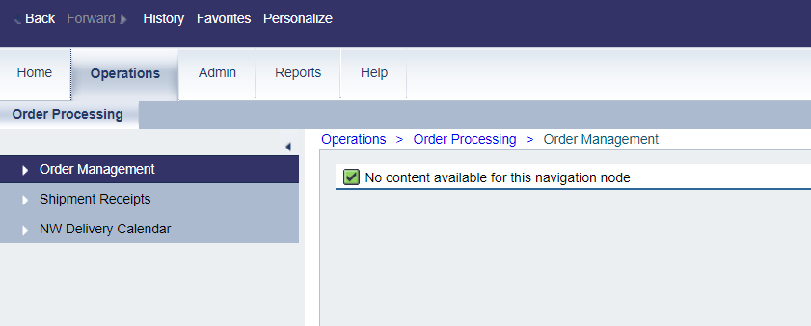
Ready For Approval
Click “Operations”
1
Click Operations Tab to return to requisitions saved in “Draft” Status
Direct Delivery via Catalog
Notes:
Order Managers will access the Operations tab in WBSCM to update requisitions.

Slide 79
Ready For Approval
2
Click “Order Management”
Click Order Management to search requisitions
Direct Delivery via Catalog
Notes:
Review information on slide with RAs

Slide 80
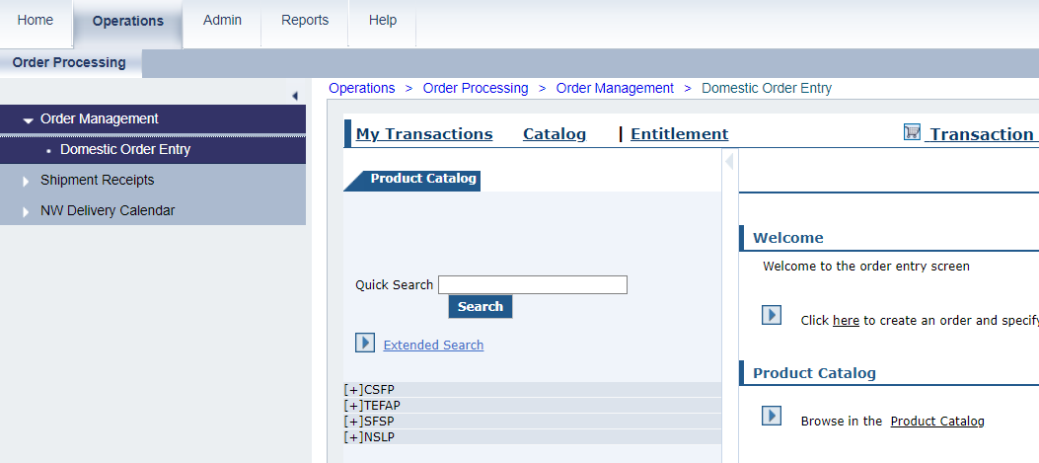
Ready For Approval
Click “My Transactions”
3
Click “My Transactions” to locate saved requisitions in Draft Status
Direct Delivery via Catalog
Notes:
Review information on slide with RAs

Slide 81
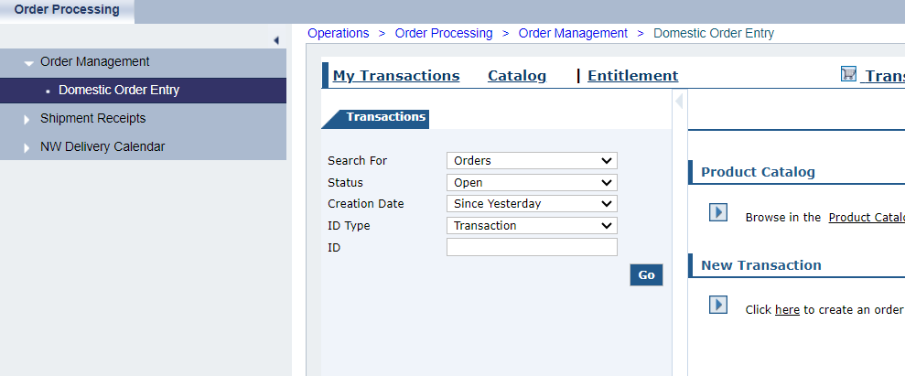
Ready For Approval
Change “Status” and “Creation Date” fields to search for saved requisitions
Direct Delivery via Catalog
Notes:
Review information on slide with RAs

Slide 82
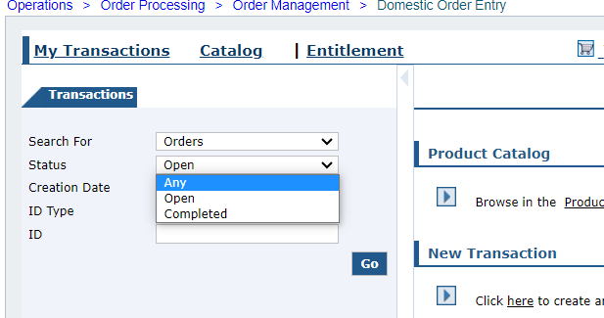
Ready For Approval
4
Click “Status” Dropdown
Click “Status” field dropdown
Change “Status” to “Any”
Direct Delivery via Catalog
Notes:
Review information on slide with RAs

Slide 83
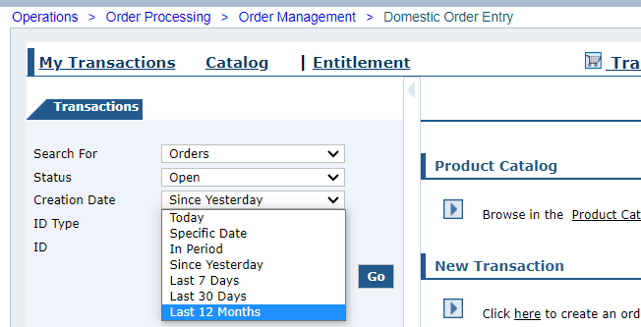
Ready For Approval
Click “Creation Date” field dropdown
Change “Creation Date” to “Last 12 Months”
Click “Creation Date” Dropdown
5
Direct Delivery via Catalog
Notes:
Review information on slide with RAs

Slide 84
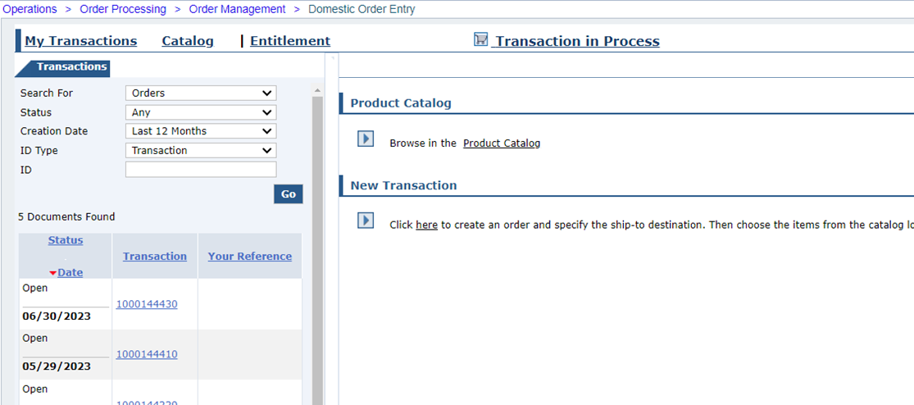
Ready For Approval
Click hyperlinked number in “Transaction” column to view requisition
6
Click hyperlink
Direct Delivery via Catalog
Notes:
Review information on slide with RAs

Slide 85
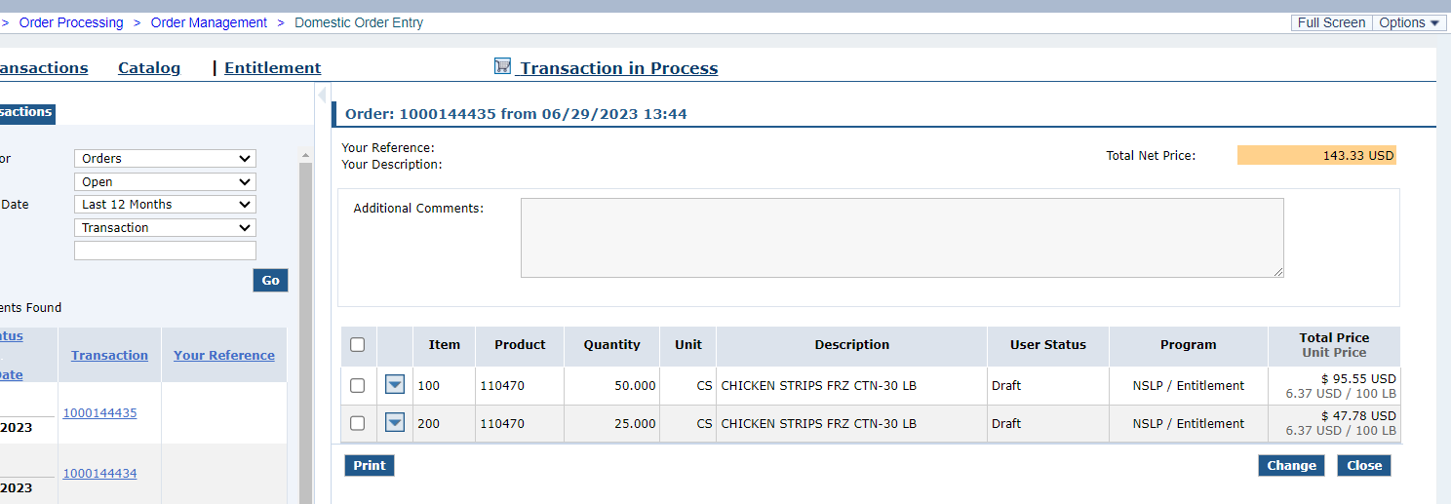
Ready For Approval
7
Update all requisitions in “Draft” status
Direct Delivery via Catalog
Notes:
Review information on slide with RAs

Slide 86
Ready For Approval
To update requisition, click the “Change” button
8
Click
Direct Delivery via Catalog
Notes:
Review information on slide with RAs

Slide 87
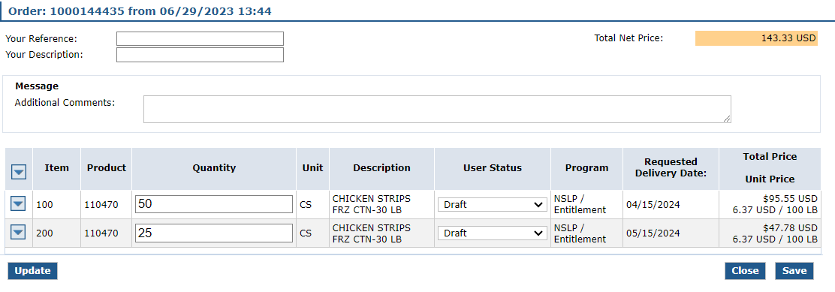
Ready for Approval
Click down arrow icon to edit Delivery Point
“Quantity” and “User Status” fields are now editable
Direct Delivery via Catalog
Notes:
Review information on slide with RAs

Slide 88
Ready for Approval
Edit quantity for line items marked as incorrect on Quality Assurance print outs
If no edits needed, leave quantities as is.
9
Direct Delivery via Catalog
Notes:
Review information on slide with RAs

Slide 89
Ready for Approval
Click down arrow icon to edit Delivery Points marked as incorrect on Quality Assurance print outs
If no edits needed, leave as is.
Direct Delivery via Catalog
Notes:
Review information on slide with RAs

Slide 90
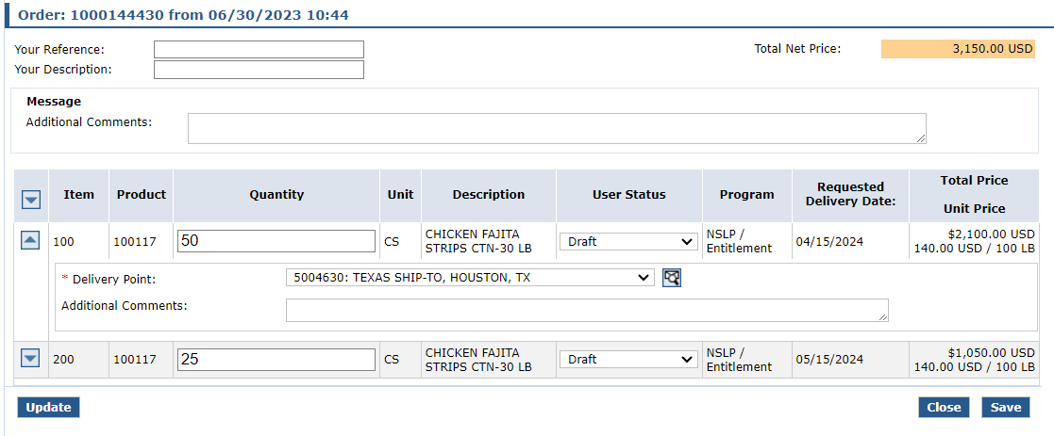
Ready for Approval
To edit Delivery Point, click drop down arrow
*Note:
All warehouses and processors will appear in Delivery Point dropdown
Select your warehouse for Direct Delivery items
Direct Delivery via Catalog
Notes:
Review information on slide with RAs

Slide 91
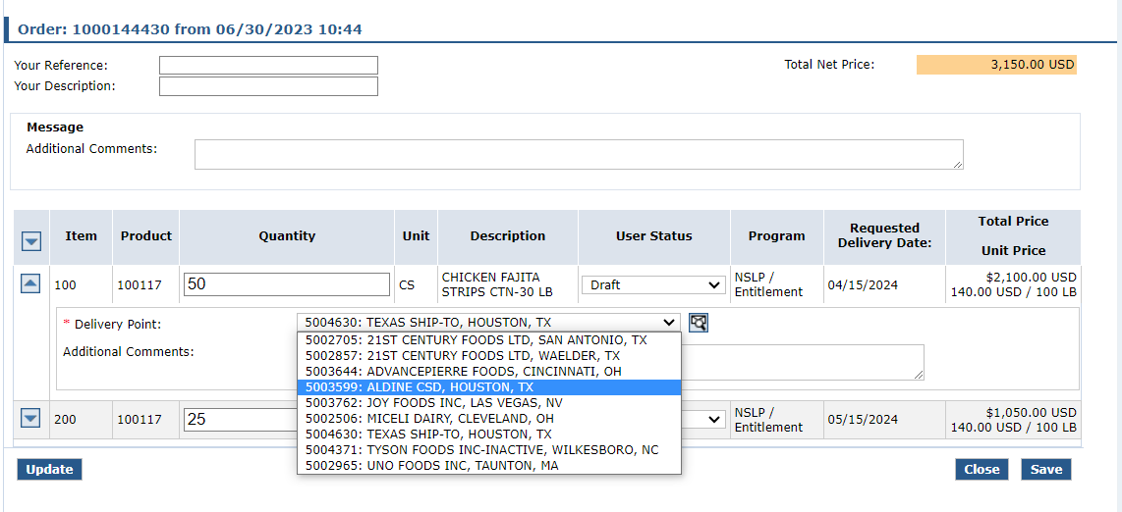
Ready for Approval
*REMINDER:
Select your warehouse for Direct Delivery
10
Choose correct warehouse from dropdown list
Direct Delivery via Catalog
Notes:
Review information on slide with RAs

Slide 92
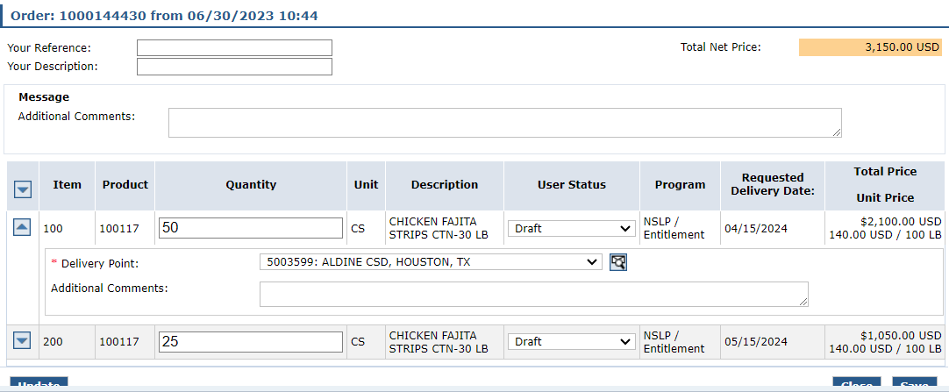
Ready for Approval
11
Click arrow to close Delivery Point dropdown if desired
Direct Delivery via Catalog
Notes:
Review information on slide with RAs

Slide 93
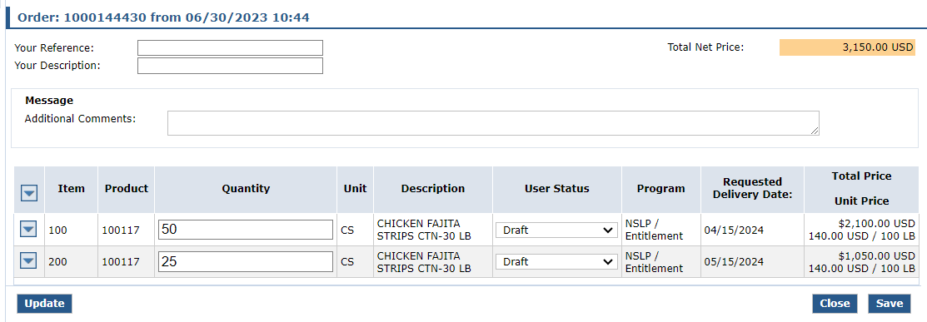
Ready for Approval
Click “Update” to save changes
Click
12
Direct Delivery via Catalog
Notes:
Review information on slide with RAs

Slide 94
Ready for Approval
13
Click dropdown in “User Status” column for each line item once all updates are complete
Direct Delivery via Catalog
Notes:
Review information on slide with RAs

Slide 95
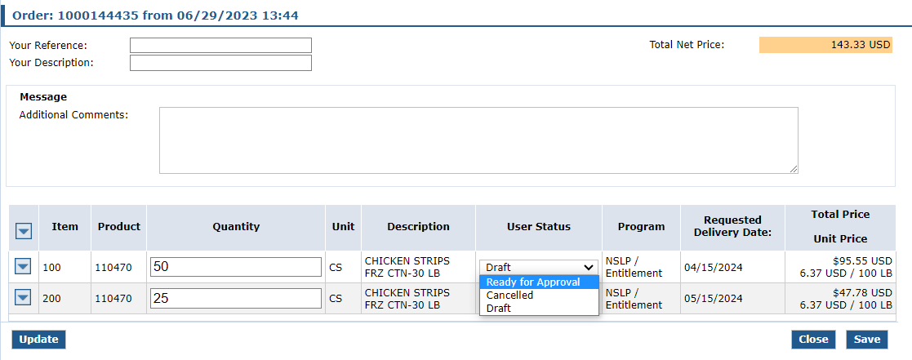
Ready for Approval
14
Select “Ready for Approval” for each line item
Direct Delivery via Catalog
Notes:
Changing User Status to Ready For Approval for each line item and updating prepares requisition for submission to TDA

Slide 96
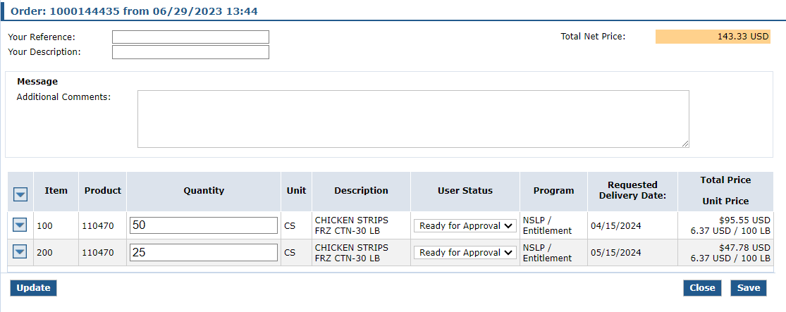
Ready for Approval
15
Click “Update” to save “Ready for Approval” status
Direct Delivery via Catalog
Notes:
Click Update to save status

Slide 97
Submit Requisition
16
Click “Save” to submit to TDA for review
Click
Direct Delivery via Catalog
Notes:
Users must click save to save changes to User Status as well as any corrections made to requisition

Slide 98
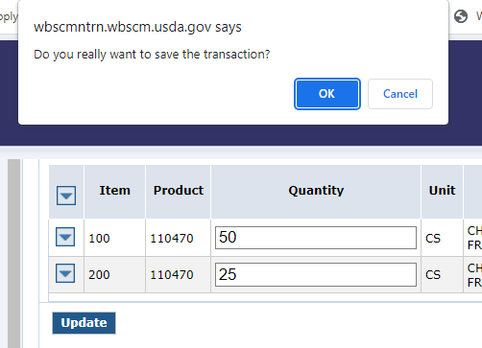
Submit Requisition
17
Click “OK” at top of screen to submit to TDA for review
Click
Direct Delivery via Catalog
Notes:
Review information on slide with RAs

Slide 99
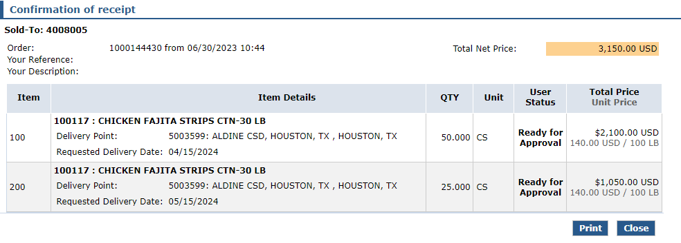
Submit Requisition
Confirmation of receipt with User Status marked “Ready for Approval” displayed
Direct Delivery via Catalog
Notes:
Review information on slide with RAs

Slide 100
Submit Requisition
18
Click Print button to print requisition for user's records as appropriate
Click
Direct Delivery via Catalog
Notes:
Review information on slide with RAs

Slide 101
Ready for Approval
Repeat Update to “Ready for Approval” for each Direct Delivery Requisition
Direct Delivery via Catalog
Notes:
Repeat the process to update transactions to Ready For Approval and submit to TDA with each Direct Delivery requisition

Slide 102
Questions?
Notes:
Collect questions in all training settings to create FAQ for RA103.

Slide 103
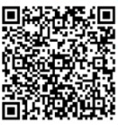
Recall, Reflect, and Release
Scan the QR Code to submit your response or click on the link below.
https://bit.ly/3CU2g4F
Notes:
Image: https://i.ytimg.com/vi/kfr4z1M6acg/maxresdefault.jpg

Slide 104
Lab Time:
Notes:
ESCs can break up RA103 Part I and RA103 Part II with lab time in between, or save Lab Time for the end of RA103 once both Part I and Part II are complete

Slide 105
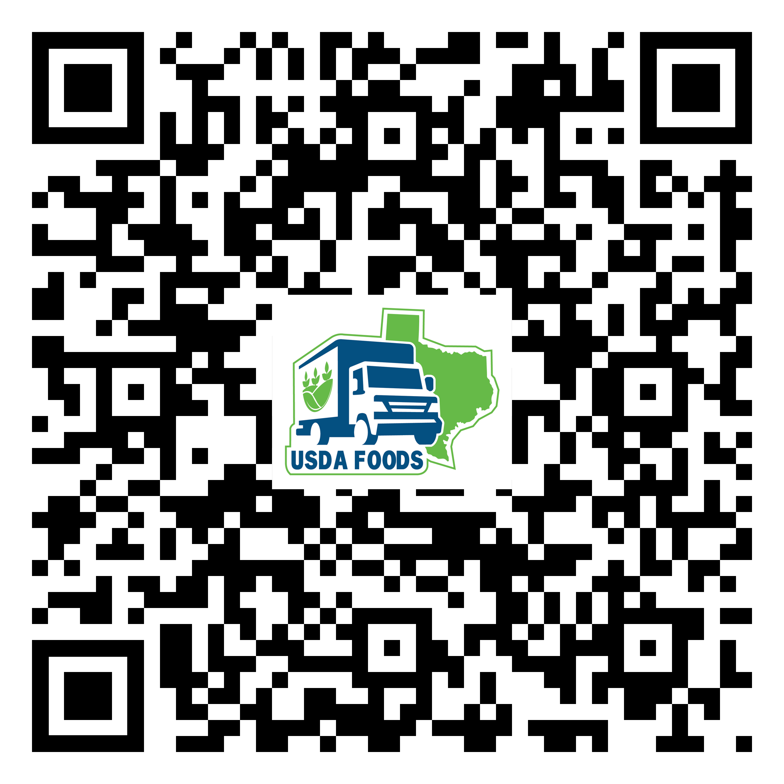
For WBSCM Resources
Visit WBSCM Transition Page

Slide 107
Contact Us
https://squaremeals.org/Programs/FDPWBSCMTransitionProject.aspx
Contact Your Education Service Center

